Slide 1
Optical Fibre networks 2/4 Multiplexing, coupling, amplifying
07/10/2024
Paul JOLIVET

Slide 2
Optical Fibre Networks : Course general objective
Get a panorama of Optical Fibre and networks
Optical Fibre characteristics and advantages
Technologies around Optical Fibre
Other components of optical fibre networks
Understand How to design high rates optical fibre networks
Existing architecture of Optical Fibre networks (FTTH, FTTA, FTTO…)
Designing a network
Deployment constraints
Understand High-rate networks trends to future
Notes:
Pour reference : https://www.researchgate.net/publication/305181019_Technologie_WDM_en_telecoms_optiques_avancees/link/57842b1208ae37d3af6c1685/download

Slide 3
Optical Fibre Networks : Course 2/4 programme
1. Coupling on optical fibre
Use cases : typically collecting FTTH
Principle and Technical solutions
2. Splitting on optical fibre
Use cases : typically securing signal
Principle and Technical solutions
4. Other passive operations
Modulator
Attenuation
Filtering
Polarisation splitting
Isolation
4. Amplifying signal
Use cases : typically long haul transmission
Principle
Technical solutions and constraints
5. Multiplexing (WDM)
Use cases : typically optimizing fibre
Principle
Various types of WDM, technologies
Technical solutions and constraints

Slide 4
Passive and active components
Two types of components
On optical fibre networks
Active components
Equipment embedding a component that emit light (including laser or LED)
Typically
Amplifiers
Routers
Active components always require to be powered
Passive components
Equipment that interfere with the light going through them (propagation, polarisation…)
Typically
Splitters
Couplers
Passive component do not mandatorily require power supply; however this could be necessary if there is a need for
monitoring
configuration

Slide 5
Coupling signals on optical fibre

Slide 6
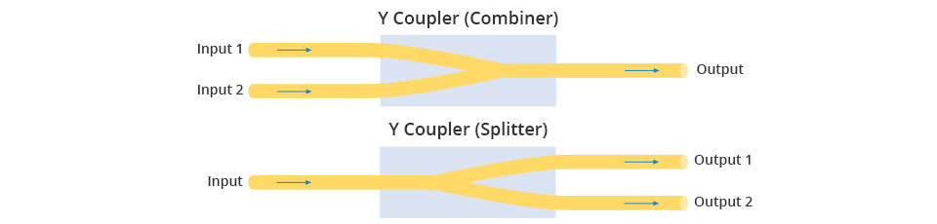
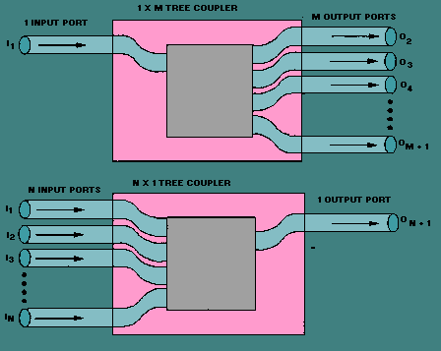
Optical fibre couplers : principles
Coupler terminology can be used to define two similar technical solutions
Multiplication of the input/output fibres with the same signal
Allows to emit a single signal from one place to multiple other places
In some cases multiple signals coming from multiple fibres to one only point
Optimizing the fibre capacity by using the free space
Several signals can physically share the fibre capacity
Principle is here to combine two inputs in a single fibre
The opposite operation is called splitting. Splitter is used for securing signals, it will be defined afterwards in this course

Slide 7
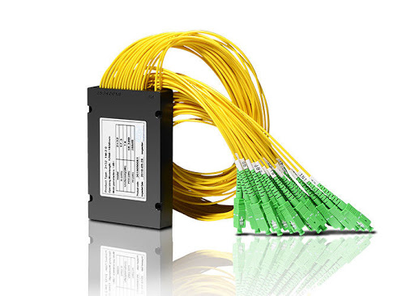
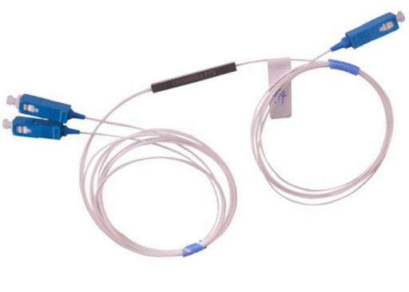
Optical fibre couplers : use cases
Optimizing resource
Several users can share the same resource that they do not need fully
Typical for FTTH infrastructures
Broadcasting signal
For systems requiring the same information to be share in multiple equipments (datacenters for instance)
Securing signal
Making it circulating by multiple ways
Preventing risk of broken cable
Doubles the required resource
Drawbacks
Sharing resource (limiting for the single user)
Loss of energy while splitting signal
Attenuation by equipments / connectors

Slide 8
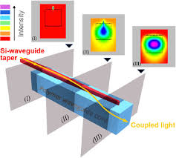
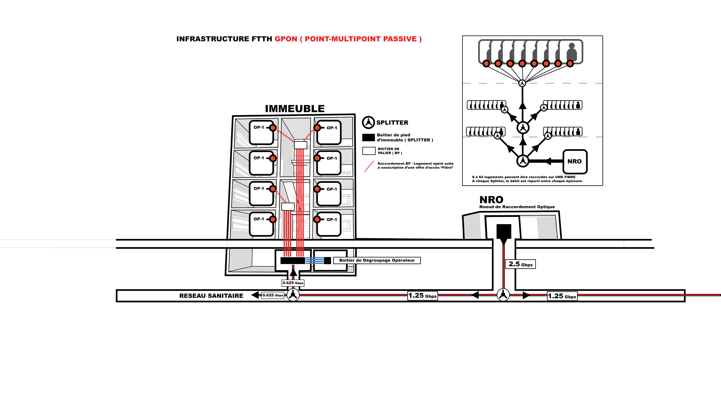
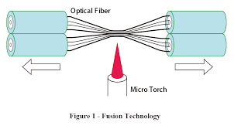
Coupling optical fibre
The principles
Sharing the input power between multiple inputs
Power splitting
Depending on the used technology, the balance of the power can be adjusted
Technical constraints
The quality of coupling is related to
Distance between waveguides
Length of coupling portion
Quality of the fibre and connection
The technical implementations
Transfer by proximity of the waveguides
Transfer by fusion
Robust solution
No component addition
Require expertise
Adapted for limited number of coupled fibres
Transfer in dedicated connectors (limit of the loss)

Slide 9
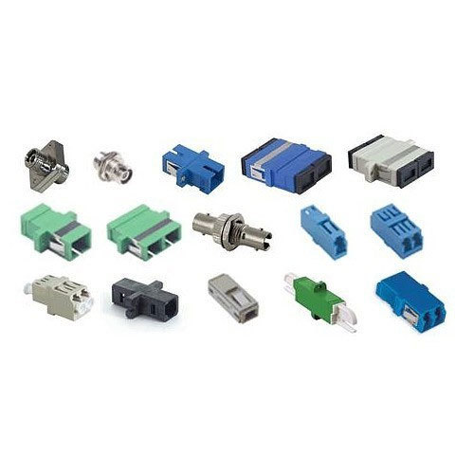
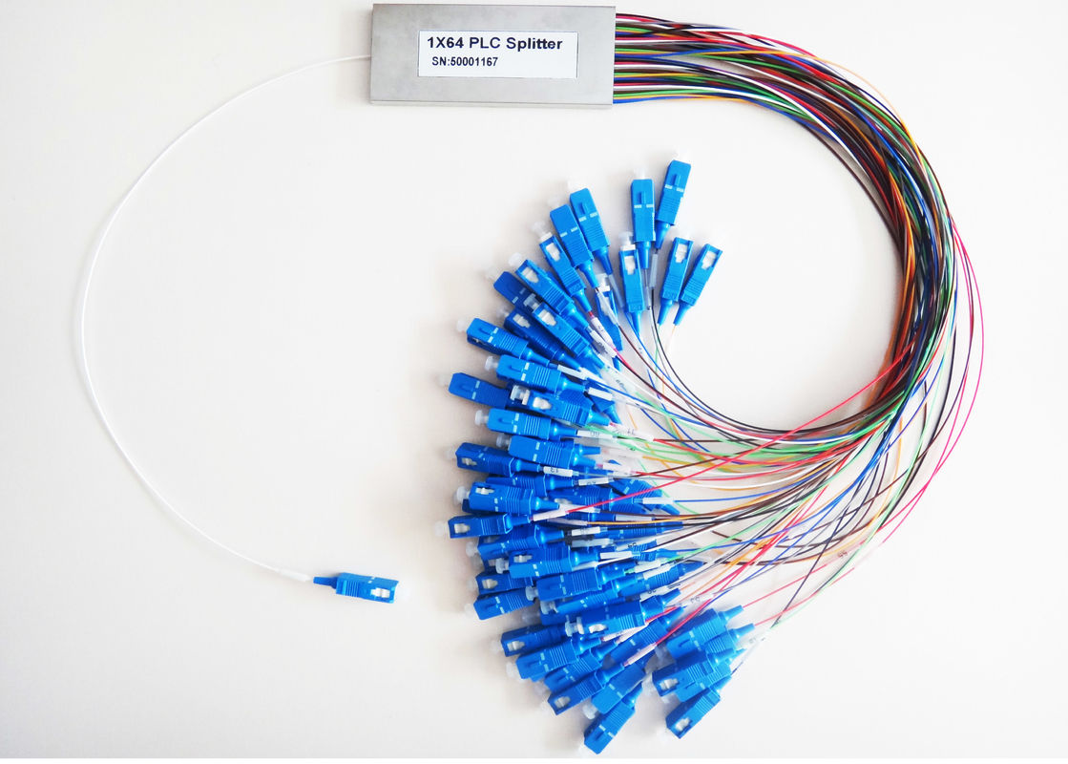
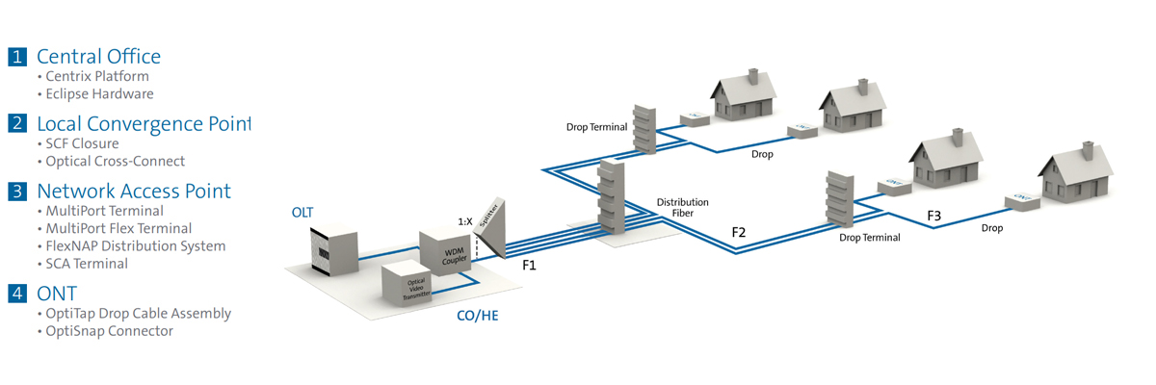
Optical couplers : equipment
This can be the story of connectors
See the picture on the side
For coupling a limited number of fibres, usually
With a warning : connectors are adding attenuation to the signal
Typical use : FTTH networks
On a GPON architecture, up to 128 users’ trafic can be coupled on a single fibre
Coupling can be made in several steps in the distribution network

Slide 10
Splitting signal on optical fibre

Slide 11
Optical fibre splitters : use cases
Broadcasting signal
Such functionality can be used for instance in datacenters where multiple equipment a redundant to ensure security and shall get the exact same information to duplicate it
Monitoring activity
Extracting part of the signal (low) to follow-up what is happening on the fibre
Securing signal by making it circulating by multiple ways
Typically used for FTTA networks based on loops
An equipment is connected by to ways to the same collection centre (or alternatively by different ways to different collection points). In case one way is damaged, the other is used.
In the case of one collection point with two identical inputs, a physical switch is used

Slide 12
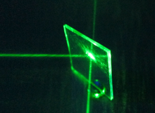
Optical fibre splitters : principles
Basic Principle
Use of a material prism/mirror
Part of the light goes straight
Part of the light is reflected
Constraints
The output signals also split energy with an unbalanced ratio (could be as much as 70/30)
An existing loss of energy in the operation for passive splitters
Either the loss of energy is acceptable for the transmission
Either it is not, in such cases, amplification shall be combined

Slide 13
Other passive functions on optical fibre

Slide 14
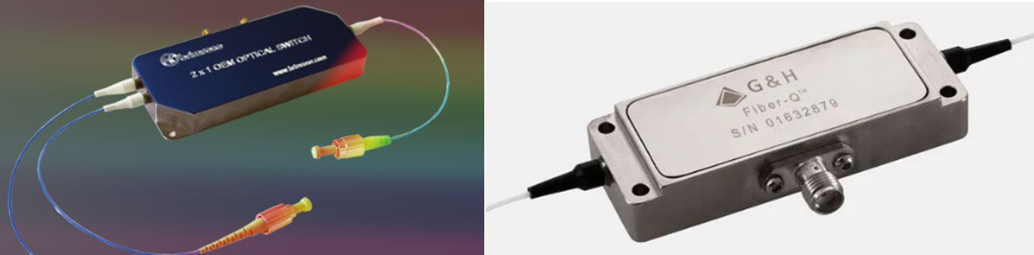
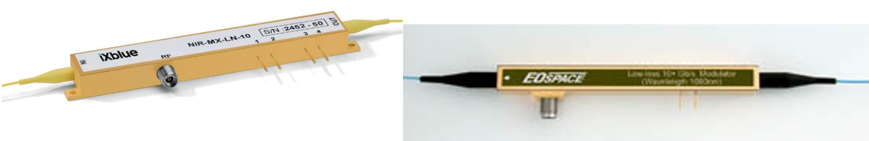
Modulator
Principle
Modulating the light signal in the fibre
Aiming at generating pulses for coding information
Modulation can be either done
By modulating the signal prior the laser diod (out of the scope here)
By modulating light after the laser diod (external modulation)
External modulation is done by
interfering with the light (some acoustic systems)
playing on the refraction on the fibre
Constraints
Loss of insertion with several dB
Some of the modulator still require energy to contain the loss of power to its minimum

Slide 15
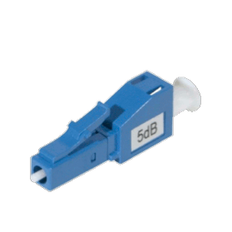
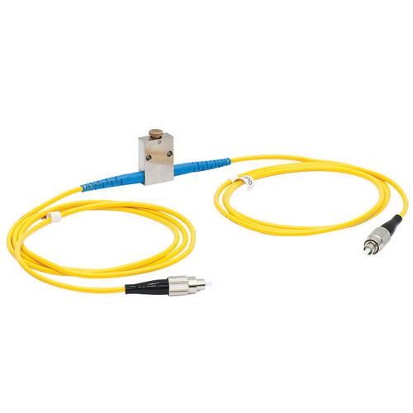
Attenuation
Principle
Reducing signal intensity on the fibre
Objective is to prevent glare on reception (for short range)
Could also compensate drift being the result of used components
Attenuation can be made
On a fixed value (typically the connector shown aside)
With a variable value (usually an active component in that case) Variable Optical Attenuator
Technology
Thermo optic
Material filtering / Liquid cristal

Slide 16
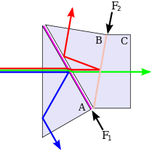
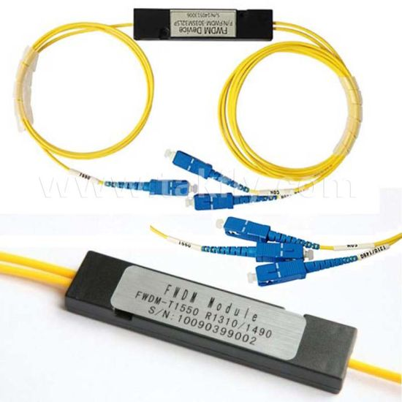
Filtering
Principle
Filtering incident signal
Prevent “noise” created by distance, unwanted coupling or active component combined with these reasons
Focus the light signal
Also used for passive WDM solutions to extract a wavelength
Technology
Bragg net
Chromatic filtering
Polar filtering by use of a set of cristals/prism

Slide 17
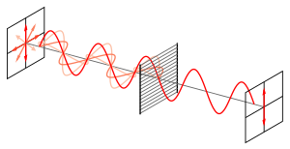
Polarisation splitting
Principle
A specific type of filter used for separating signals with different polarisation or to compensate the polarisation drift
Technology
Based on cube prisms
Use of calcit properties
The main point is to get parallel propagation direction after the application of the polarisation filter

Slide 18
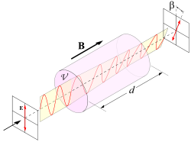
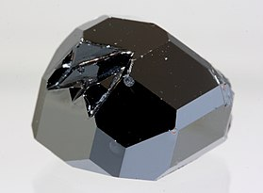
Optical isolator
Principle
A specific type of filter used for allowing only one propagation direction in the fibre
The main aim is to eliminate parasite reflexions of the signal within the optical fibre
Technology
Usually based on a Faraday rotator that
polarize the signal
optical fibre properties that looses orthogonal propagation
strongly attenuate the parasite propagations
The Faraday rotator is based on cristal. Each cristal has a Verdet constant that characterize an absorption to a certain wavelength Typically for telecom optical fibre: Yttrium Iron Garnet
Y₃Fe₂(FeO₄)₃

Slide 19
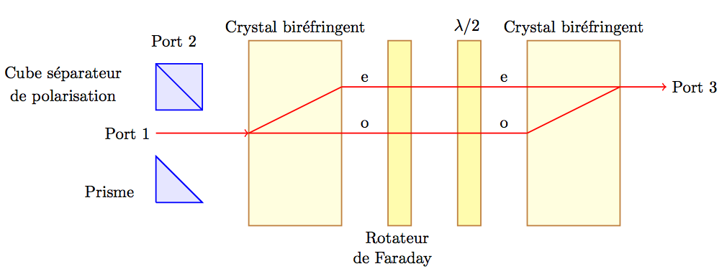
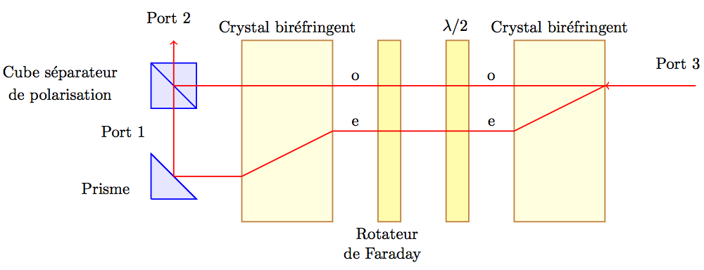
Optical circulator
Principle
A component that allows to have several light signal in a single fibre, typically to separate opposite sides propagation
A solution for bidirectional communication
Technology
A 3-port approach using
A Faraday rotator for the signal polarization
Cristal, used as prisms/mirror
To reduce interferences in this operation, orthogonal polarization is used commonly in this circulator
The Faraday rotator is based on cristal. Each cristal has a Verdet constant that characterize an absorption to a certain wavelength Typically for telecom optical fibre: Yttrium Iron Garnet

Slide 20
Amplifying signal on optical fibre

Slide 21
Amplifier and regenerator
One objective
Long distance communication implies attenuation and has limits
Signal has to be maintained in order to connect distant points (over oceans for instance)
Two principles
Amplifier
Signal amplification
Regenerator
Signal amplification
Reshape the signal to prevent distorsions
Synchronize the signal
Both components are active as requiring to boost signal energy as a minimum
The regenerator is a component that is completely adapted to the rate and protocol as getting as deep as reshaping/synchronizing it. It works as a receiver/emitter

Slide 22
Optical amplifier characteristics
Principle
Amplification without conversion (i.e. no work on the content itself). It is usually stimulated by a gain medium and doping ions in this structure.
In some cases additional light is generated to dope the signal. In those cases some parameters can apply to focus amplification
Technical solutions
Various solutions applicable to optical fibre:
EDFA
Semi-conductor optical amplifier
Raman amplifier
Optical parametric amplifier
G

Slide 23
Semi conductor amplification (SOA)
Principle and characteristics
The gain medium is embedded in a semiconductor
The pump is powered by electricity
Semiconductor characteristics
Anti-reflection coating with a result of less than 0,001%
Usual semiconductors can operate in the band of 850 and 1600 nm
Gains can be up to 30dB
Pros and cons of the technology
Much less expensive than other technical solutions
Higher noise
Lower gain
Risk of non-linearity on the signal

Slide 24
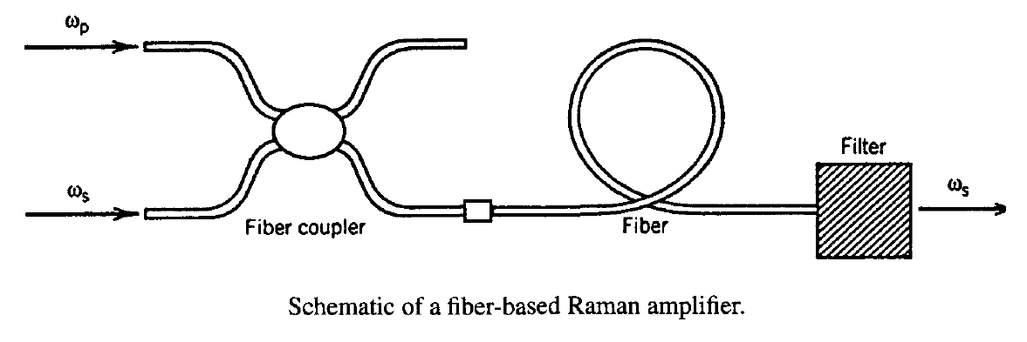
Raman amplifier
Principle and characteristics
The basic principle is to create the amplification by a non-linear interaction with the fibre (used as the gain medium) and multiplexing:
the signal
a pump laser
The coupling can be directional, contra-directional or in some cases a combination of the two.
This also implies filters to compensate the coupling effects on the line
Pros and cons of the technology
Higher power requirement compared to EDFA
Can be adjusted in terms of wavelength to the exact need
Amplification is reasonably flat over the wavelength (note that this could be a serious drawback as this implies amplifying noise as well)

Slide 25
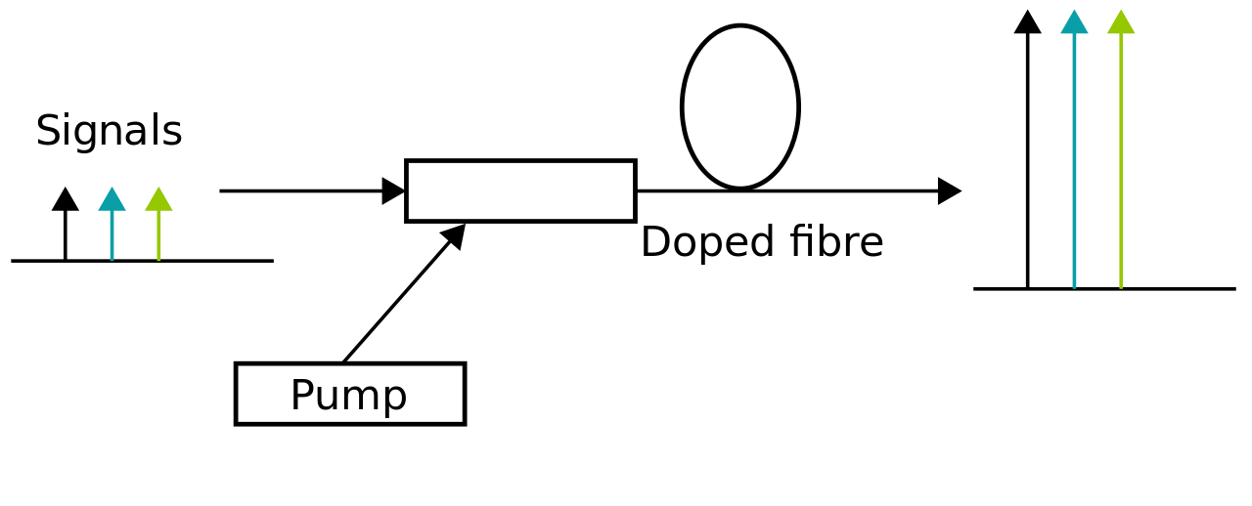
EDFA amplification
DFA Principle
The principle is to force the signal through a doped fibre
The medium is powered by a pump that excites ions in the section of the doped fibre.
The interaction between those ions and the signal creates the amplification
Characteristics
Amplification window
Range of wavelengths
Spectroscopic properties of the dopant ions
Structure of the glass matrix of the doped fibre
EDWA (erbium-doped waveguide amplifier)
DFA amplifier including a waveguide to boost
Erbium ions are used in the doped fibre (corresponds to the used wavelength between 980 and 1480 nm)

Slide 26
Multiplexing on optical fibre

Slide 27
Multiplexing problematic
Optimization of the ressource
Fibre optic capacity is huge
The limitation is still on the emitting/receiving equipments
Reality is
The total demand in terms of capacity is currently doubling every year
Multiplicity of emitters and receivers
The expected capacity of each transmission is reasonnably significant
FTTH sold capacity is about 1-2 Gbps per user, maximum rate
5G radio site target maximum rate is about 10-25 Gbps
The largest customers are point to point
The equation is:
Deploying future proof infrastructures (not adding cables on regular basis)
Not making bicycles running on motorways, reducing capacity

Slide 28
Multiplexing technical solutions
Frequency division (Wavelength)
The frequency band is split into sub-bands, allocated each to a user
The challenge is to make the best compromise between
the correct size for the sub-band (vs rate)
the space between bands to master interferences
Time DIvision
Time slots are allocated to each users
Allows to combine multiple low rate messages into a high rate signal
The limit is the compromise between available rate and real time combination
Code Division
The principle is to share the whole bandwith and to identify the users by a code signature
Used a lot in the radiofrequency systems, some trials in the optical world
Combination of solutions
frequency
time
frequency
time

Slide 29
Multiplexing light principle
Wavelength Division Multiplexing (WDM)
The optical fibre bandwidth it split into n carrier bands
Each band allows communication for a modulated signal
Some constraints:
- Space between bands to avoid interferences
- Total bandwidth (limitations of equipments)
Note that this is similar to FDD, however, in WDM case, the delta between band is large compared to the wavelength (here approximately 1nm)
Further multiplexing
In addition to WDM, Time Division Multiplex can apply to each of the emitter/receivers
λ₁
λ₁
λ₂
λ₂
MUX
Optical Fibre
deMUX
λ_{n}
λ_{n}

Slide 30
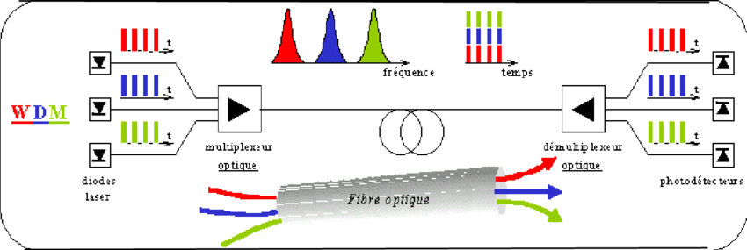
Wavelength and multiplexing
Multiplexing sources
The system used at that time allows up to 64 bands on a fibre which allows typically up to 640 Gbps (with the assumption of the typical 10Gbps channels… to be enhanced)
Technical requirement
Need for transceivers to adjust the signal to
Allocation of carrier wave

Slide 31
WDM technologies : DWDM
Dense Wavelength Division Multiplexing
Principle is that technology is called dense as soon as the space between bands is lower than approximately 1nm
Up to 160 wavelength on the same fibre
Space between wavelength is typically:
either 0,2nm (corresponds to 25GHz), i.e. 160 bands
or 0,4nm (corresponds to 50GHz), i.e. 80 bands
Implies electronics to regulate laser temperature
Typical use
A costly technology compared to other WDM implementations
Preferably used for long haul connections (typically submarine cables)
Dedicated to point to point connections
A variation of DWDM : U-DWDM (ultra dense)
Bands space at 0,08nm, up to 400 channels available

Slide 32
WDM technologies : CWDM
Coarse Wavelength Division Multiplexing
Wavelength are spaced by a guard of 20nm
Allows up to 18 channels on the same fibre
Typical use
Cheaper than DWDM but optimizing less the resource
Used a lot for terrestrial communication
Local
Metropolitan
Applicable to
A variation of DWDM : WWDM (Wide)
Only 4 channels are allowed

Slide 33
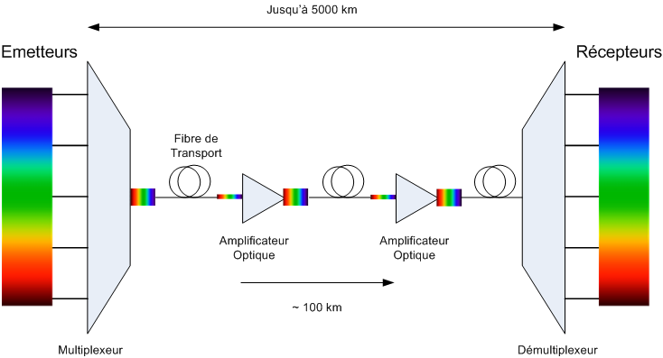
WDM Fibre optic networks topology
Coarse Wavelength Division Multiplexing
Wavelength are spaced by a guard of 20nm
Allows up to 18 channels on the same fibre

